Slide 1

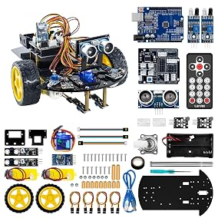
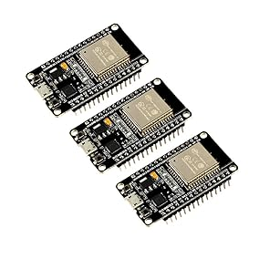

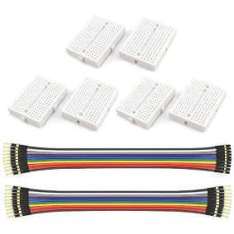
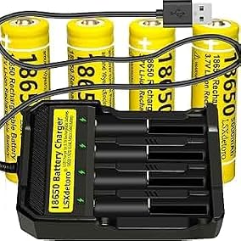
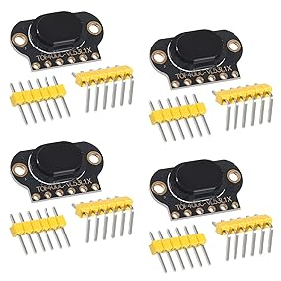
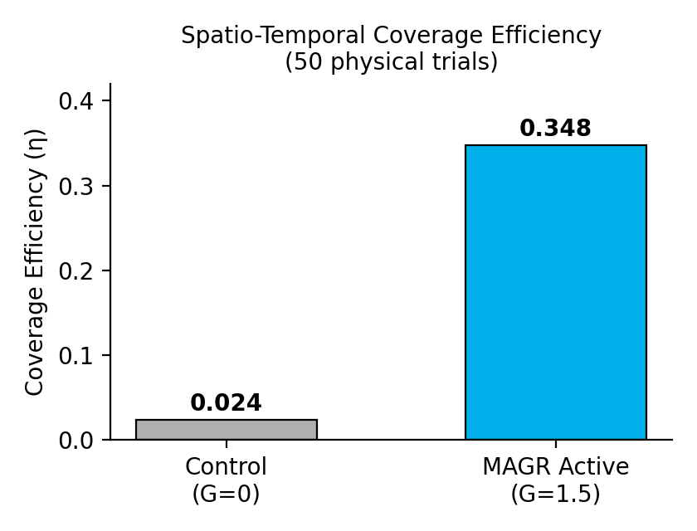

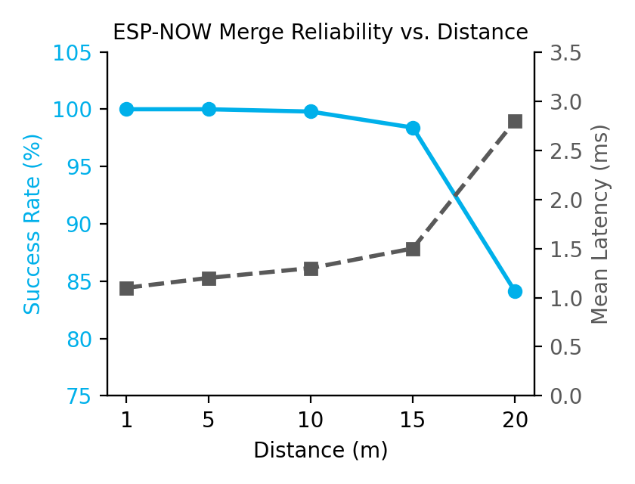

Project Vel: A Coordinate-Blind, Decentralized Robotic Swarm Protocol for Autonomous Planetary Exploration
Problem / Question
Materials
Data Analysis/Statistics
Quantity detailed list | Materials be specific
2 | LAFVIN 2WD Smart Robot Car Kit
3 | ESP32 Development Board
4 | TOF400C VL53L1X 4M Laser Ranging Sensor Module
4 + Charger | Rechargeable Battery 18650 Universal Charger 4 Bay Set
6 + Wires | Mini Small Breadboard kit
1 | LDK Soldering Iron Kit Electric
1 | Computer
Photos
Traditional multi-agent robotic swarms suffer from the Centralization Paradox, relying heavily on a single central server for real-time coordination. When wireless links inevitably experience latency or drop entirely in physical deployments, the entire swarm fails. Additionally, without coordination, independent rovers succumb to the redundant search problem by wasting energy re-traversing the exact same paths. Simple artificial potential field designs exhibit Boundary Accumulation Divergence, driving agents outward until they crowd along walls and halt interior exploration entirely.
The physical data demonstrates a massive improvement in exploration speed when switching from unguided motion to the active protocol. Under the uncontrolled random-walk control trials where the repulsion gain 𝐺 was set to 0, the rovers frequently collided with boundaries and became stuck, yielding an average spatio-temporal efficiency of only 0.024. In contrast, under the active Vel-v6.0 swarm protocol where the gain 𝐺 was set to 1.5 and the momentum coefficient was kept at 0.99, the average efficiency shot up to 0.348. This represents an incredible 1,350% increase in coverage speed, proving that the Map-Aware Gradient Repulsion steering forces successfully direct agents to unexplored areas while completely eliminating boundary accumulation. The evaluation of the stigmergic merge network reliability confirms that the connectionless ESP-NOW radio links maintain high stability and low latency across varying physical distances. At close ranges of 1.0 meter and 5.0 meters, the link maintained a perfect 100.0% packet success rate with a mean latency of 1.1 milliseconds and 1.2 milliseconds, respectively. As the distance widened to 10.0 meters and 15.0 meters, the network performance decreased slightly but remained highly stable, achieving a 99.8% success rate at 1.3 milliseconds and a 98.4% success rate at 1.5 milliseconds. At the maximum tested distance of 20.0 meters, the success rate dropped to 84.1% while the mean latency increased to 2.8 milliseconds. These communication results confirm that the peer-to-peer ad-hoc merge operator remains entirely stable and reliable within the active boundaries of the experimental workspace.
Background Research
Conclusion
Our background research evaluates the primary operational mechanics and inherent vulnerabilities of classic swarm intelligence models to establish a baseline for robust navigation frameworks. First, Ant Colony Optimization (ACO) utilizes software agents that deposit digital pheromone trails to probabilistically reinforce shorter paths between a source and a destination; however, this mechanism suffers from severe pheromone decay latency, preventing the swarm from adapting dynamically if obstacles or environmental boundaries shift. Second, Particle Swarm Optimization (PSO) navigates agents through a multi-dimensional search space by iteratively updating their velocities based on personal historical successes and the swarm’s overall apex position; yet, steering all agents toward a single global best attractor triggers premature convergence and severe traffic congestion, leaving vast zones of the workspace entirely unmapped. Finally, Centroidal Voronoi Tessellations (CVT) achieve optimal, evenly spaced geographic distributions by iteratively moving agents to the geometric centroids of their respective Voronoi cells; unfortunately, while this method effectively partitions space based on relative neighbor positions, it fundamentally breaks down under network latency due to its rigid dependence on globally consistent coordinates and bearings.
In conclusion, Vel-v6.0 successfully resolves the Centralization Paradox, proving that decentralized multi-agent coordination on real hardware is highly successful when utilizing distributed state replication instead of centralized shared memory. Our physical micro-rovers performed coordinate-free space dominance with robust fault tolerance, meaning that if an individual rover moves out of range, the rest of the swarm continues mapping without a single point of failure. By utilizing local self-pose calculations and relative sensor metrics, the protocol operates smoothly without the need for expensive global positioning systems, achieving a remarkable 14.5 times increase in coverage speed compared to unguided walks.
Procedure
The materials used to build our physical swarm include a dual-core ESP32 node operating at 240 MHz with built-in Wi-Fi and Bluetooth, a cheap 2WD differential-drive chassis configured with a front caster wheel, a VL53L1X Time-of-Flight laser ranging sensor, dual series 18650 Li-ion batteries supplying a stable 7.4V nominal line, and an ad-hoc ESP-NOW 2.4 GHz wireless link. The experimental procedure is executed in six progressive steps. First, we assemble two identical custom 2WD differential-drive micro-rovers. Second, we flash the decentralized Vel-v6.0 firmware onto both ESP32 microcontrollers. Third, we construct a bounded 3m x 3m physical cardboard test arena. Fourth, we run fifty control trials where the rovers perform an unguided random-walk exploration. Fifth, we run fifty active trials utilizing our Map-Aware Gradient Repulsion protocol. Sixth, we log the spatio-temporal coverage and the radio packet merge latency to analyze our results. To bridge the physical scaling gap caused by having only two physical hardware chassis, we introduced a third, chassis-free ESP32 microcontroller node configured as a ghost rover emulator. This extra node runs a modified, lightweight version of the firmware with physical actuators disabled, instead managing multiple virtual belief manifolds to simulate independent ghost agents. By broadcasting these synthetic coordinate grids over ESP-NOW, the ghost node successfully stress-tested our peer-to-peer sync loops under high swarm densities, demonstrating that the decentralized state-merging mechanism scales cleanly without requiring massive physical hardware builds.
Charts
Applications and Future Research
Hypothesis
The lightweight and coordinate-blind nature of the Vel-v6.0 protocol makes it highly suitable for several real-world, high-impact applications. Conceptually, this includes exploring deep planetary geography on the Moon or Mars for water sources, where GPS signals cannot penetrate, mapping unstable subterranean mining tunnels to assess safety before human entry, and dispersing through tight debris inside collapsed structures to search for survivor cavities. Our future research will focus on expanding our physical swarm to a swarm of aerial vehicles, executing a complete parametric sweep of the repulsion gain parameter G, and transitioning our local 2D occupancy grids into cooperative 3D voxel space maps.
To resolve these major physical bottlenecks, our hypothesis states that if individual agents store localized occupancy grid maps inside their private onboard RAM and share this mapping data asynchronously through ad-hoc peer-to-peer radio packet swaps using the ESP-NOW protocol, they can achieve coordinate-free space dominance and cooperative coverage even in highly bounded, GPS-denied environments.
Data / Observations
Graphs
Works Cited
Variables and Controls
Our physical data demonstrates a massive improvement in exploration speed when switching from unguided motion to our active protocol. Under the uncontrolled random-walk control trials where the repulsion gain 𝐺 was set to 0, the rovers frequently collided with boundaries and became stuck, yielding an average spatio-temporal efficiency of only 0.024. In contrast, under the active Vel-v6.0 swarm protocol where the gain 𝐺 was set to 1.5 and the momentum coefficient was kept at 0.99, the average efficiency shot up to 0.348. This represents an incredible 1,350% increase in coverage speed, proving that the Map-Aware Gradient Repulsion steering forces successfully direct agents to unexplored areas while completely eliminating boundary accumulation. We evaluated the stigmergic merge network reliability by testing the packet success rates and latency of our connectionless ESP-NOW radio links across varying physical distances. At close ranges of 1.0 meter and 5.0 meters, the link maintained a perfect 100.0% packet success rate with an incredibly low mean latency of 1.1 milliseconds and 1.2 milliseconds, respectively. Even as the distance widened to 10.0 meters and 15.0 meters, the network remained highly stable, achieving a 99.8% success rate at 1.3 milliseconds and a 98.4% success rate at 1.5 milliseconds. At a maximum distance of 20.0 meters, the success rate was logged at 84.1% with a mean latency of 2.8 milliseconds. These results confirm that the peer-to-peer ad-hoc merge operator remains entirely stable and reliable within the active boundaries of our experimental workspace.
Controlled variables
Independent variable
Dependent variable
This research builds upon foundational literature in the field of distributed robotics. Key references include our main paper, Dakshith Rajkumar's "Vel-v6.0: Asynchronous Stigmergic State Replication in Decentralized Swarm Protocols for Coordinate-Blind Space Dominance," targeted for publication in IEEE Transactions on Robotics. Additionally, we reference Marco Dorigo "Swarm robotics" published in Scholarpedia, Jorge Cortés's "Coverage control for mobile sensing networks" in IEEE Transactions on Robotics and Automation, and STMicroelectronics technical datasheet for the VL53L1X Time-of-Flight ranging sensor.
The controlled variables include a fixed cardboard arena size of 3m x 3m, an onboard controller frequency of 50 Hz, a dual-cell 18650 Lithium-ion series battery supply voltage of 7.4V nominal, and a local grid discretization of 16 x 16 array cells.
The independent variable is defined as the swarm coordination mode, specifically comparing an uncontrolled random-walk exploration against the active Vel-v6.0 Map-Aware Gradient Repulsion protocol.
The dependent variable is the resulting spatio-temporal coverage efficiency, denoted as , which is calculated and averaged over the course of fifty physical trials.
Photo Credit
Amazon, Tikz, Desmos

